Slide 1
Condensed Representations Of Incidence Matrix and Adjacency Matrix of a Graph
Group members
Yogesh Gupta (IRM2014004)
Akshat Aggarwal (IIM2014005)
Vishesh Middha (ISM2014007)

Slide 2
Motivation
Graphs have numerous applications.
They are used in social networks, transportation networks, document-link graphs, robot planning and many more.
So for above mentioned real life applications, where the size of graph is large and the cost of allocating the space is more, the matrix representations of graph become costly.
This motivates us to represent our graphs in some condensed and compressed form, so that space complexity should not be a problem and we can focus on other important aspects.

Slide 3
Algorithms Used
Binary to Decimal Conversation
Conversion to Lists
Saving a Triangular Half
Run Length Encoding
Note: The Graphs considered in this problem are simple graphs.
Simple graph: A simple graph (also called as a strict graph) is an unweighted, undirected graph containing no self-loops or multiple edges.

Slide 4
Algorithm #1: Binary to decimal conversion
result = []
for row in M do
value = 0, power = 0, numbers = []
for i = 1 to row.length do
value = value + row[i] * 2^{(power)}
power = power + 1
if power == 64 then
value = 0, power = 0
numbers.append( value )
endif
endfor
result.append( numbers )
endfor
return result
Worst Case Complexities:
Incidence Matrix:
Time: O(V x E)
Space: O(V x E)
Adjacency Matrix:
Time: O(V x V)
Space: O(V x V)

Slide 5
Algorithm #2: Conversion to Lists
result = []
for row in M do
encoded_list = []
for i = 1 to row.length do
if row[i] == 1 then
encoded_list.append(i)
endif
endfor
result.append(encoded_list)
endfor
return result
Worst Case Complexities:
Incidence Matrix:
Time: O(V x E)
Space: O(V x E)
Adjacency Matrix:
Time: O(V x V)
Space: O(V x V)

Slide 6
Algorithm #3: Saving a triangular-half of the matrix
Worst Case Complexities:
Incidence Matrix:
Time: O(V x E)
Space: O(V x E)
Adjacency Matrix:
Time: O(V x V)
Space: O(V x V)
result = []
for i = 1 to n do
row = []
for j = 1 to i do
row.append( M[i][j] )
endfor
result.append( row )
endfor
return result

Slide 7
Algorithm #4: Using run-length encoding
result = []
for row in M do
encoded_row = [], count = 1
for i = 1 to row.length-1 do
if row[i] == row[i+1] then
count = count + 1
else
encoded_row.append( {row[i], count} )
count = 1
endif
endfor
encoded_row.append( {row[row.length], count} )
result.append(encoded_row)
endfor
return result
Worst Case Complexities:
Incidence Matrix:
Time: O(V x E)
Space: O(V x E)
Adjacency Matrix:
Time: O(V x V)
Space: O(V x V)

Slide 8
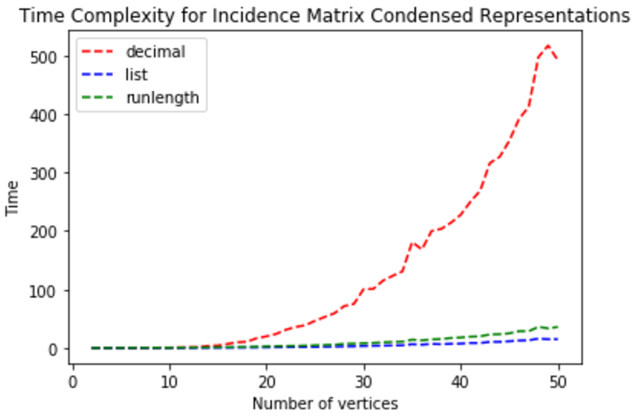
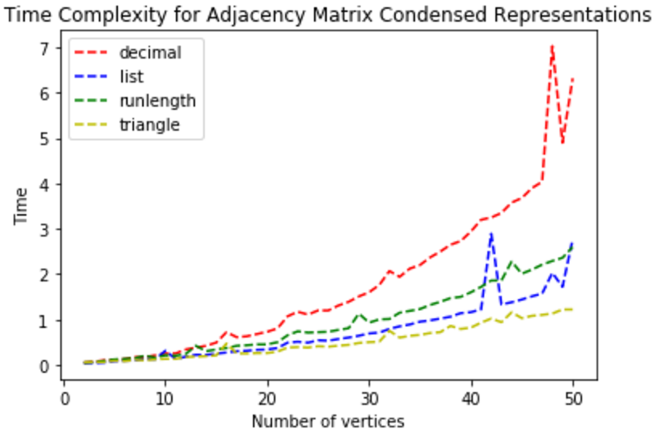
Results & Conclusions - Time Complexities
Incidence Matrix
Adjacency Matrix

Slide 9
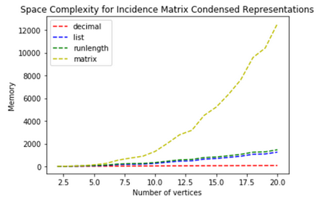
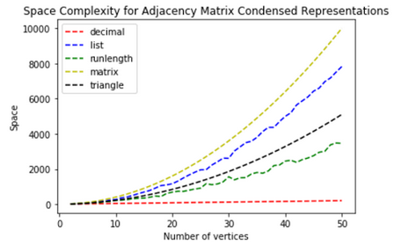
Results & Conclusions - Space Complexities
Incidence Matrix
Adjacency Matrix

